Slide 1
Intermediate Statistics
Lecture 3: Measuring Uncertainty 1
January 24 – January 31, 2024
HAD5772 • Alex Hoagland, Ph.D.

Slide 2
Last Time
Data visualization is a powerful tool: use it well
Measuring correlations and covariances (but not causation – yet!)
Quantifying (some) uncertainty: standard deviations
This Time
Quantifying (more) uncertainty
Standard errors
Confidence Intervals

Slide 3
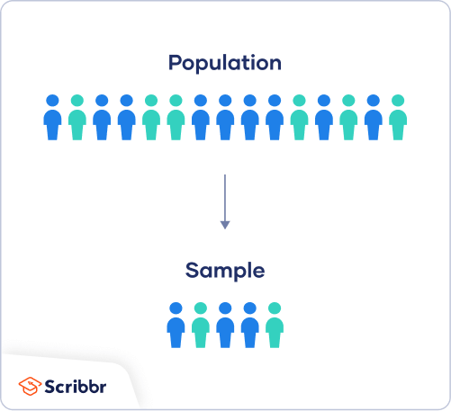
Populations and Samples
What do we assume about a sample?
Random: every subject has an equal likelihood of being in the population

Slide 4
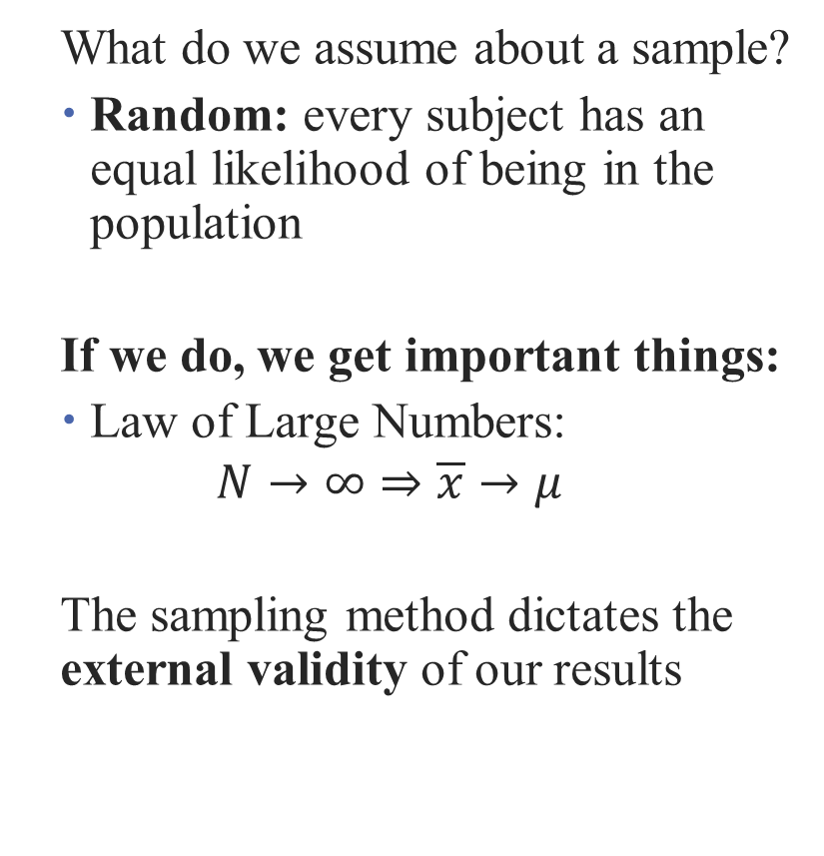
Populations and Samples
What do we assume about a sample?
Random: every subject has an equal likelihood of being in the population
If we do, we get important things:
Law of Large Numbers:
$$N→∞⇒\overline{x}→μ$$
The sampling method dictates the external validity of our results
Notes:
It also dictates how we measure uncertainty!

Slide 5
Standard Errors

Slide 6

Standard Errors
But different samples will give us different values for our statistics
How can we measure this?
Notes:
It also dictates how we measure uncertainty!

Slide 7
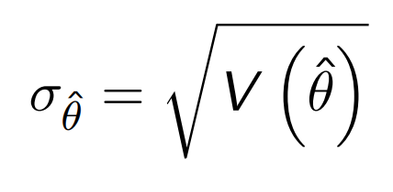
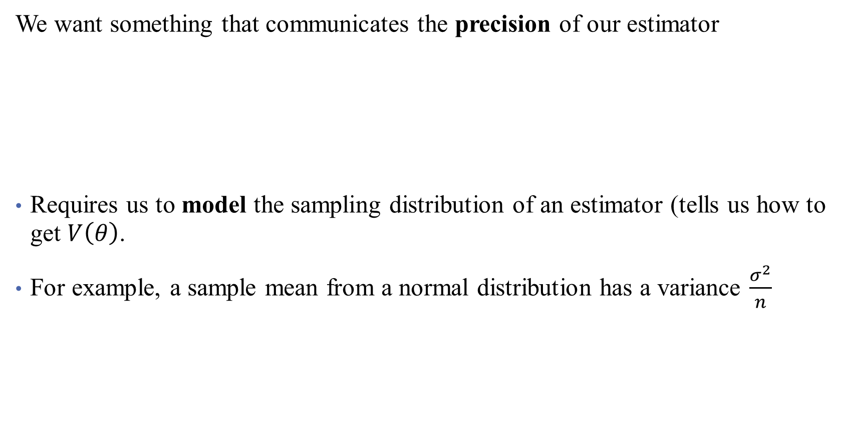
Standard Errors
We want something that communicates the precision of our estimator
Requires us to model the sampling distribution of an estimator (tells us how to get $V\left(θ\right)$.
For example, a sample mean from a normal distribution has a variance $\frac{σ^{2}}{n}$

Slide 8
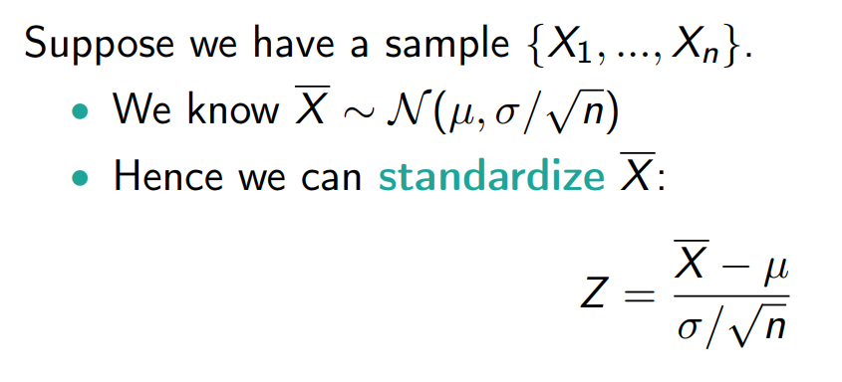

Standard Errors “Standardize” a Variable
Standard errors!
Notes:
Note: here for simplicity we assume that we know mu and sigma (population values) but obviously we don’t in reality.

Slide 9
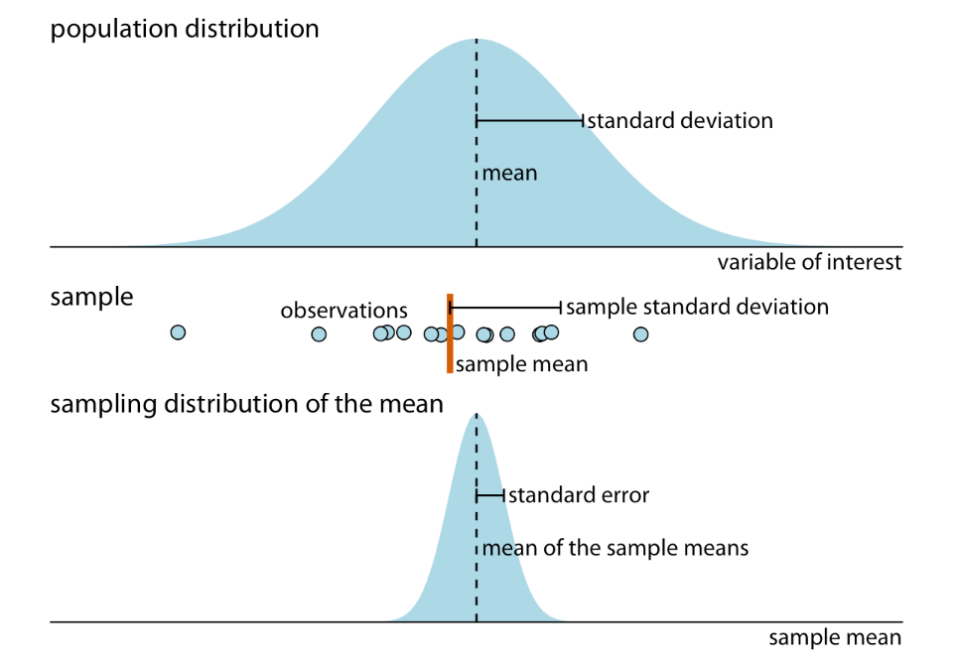
Okay but what is it?
Notes:
Think of the SE as the standard deviation for the distribution of the sample means. We get the closed form here when we are willing to make assumptions.

Slide 10
Some Cautions about the Standard Error
Some common misconceptions:
Myth: Small standard errors indicate less variability among data
Fact: With a large enough sample size, your standard errors necessarily decrease. In the age of big data, don’t mistake small SEs for no variation in data!
Fact: The SE quantifies how well you have estimated the population mean
Myth: If two means have SE’s that don’t overlap, then means are significantly different.
Fact: Just run the test! There are lots of cases where this isn’t true.
Myth: Measurement error affects the SE
Fact: Not if the measurement error is consistent! Since the SE is for the distribution of sample means, if all the sample means are affected in the same way, the SE won’t change. Watch out for this!

Slide 11
Plotting Uncertainty: More Data Viz
When is it useful to plot error bars?
Show time series with effect that seems large when you zoom in, small when you set y-axis to 0.
What about error bars when it looks significant?
What about if error bars when it doesn’t look significant? (but there is a consistent trend pre/post)?
What about tradeoff between showing SD and SE?
Show the option of showing (i) mean + SD, (ii) mean + SE, (iii) mean + 95% CI, (iv) median + quartiles
How should you format errors? (Really up to you)

Slide 12
Sampling Distributions

Slide 13
Common Sampling Distributions
Discrete
Bernoulli (coin flip)
Geometric (how many coin flips until heads?)
Binomial (how many heads do I have?)
Poisson (how often do heads occur?)
Continuous
Notes:
We’ll come back to Poisson

Slide 14
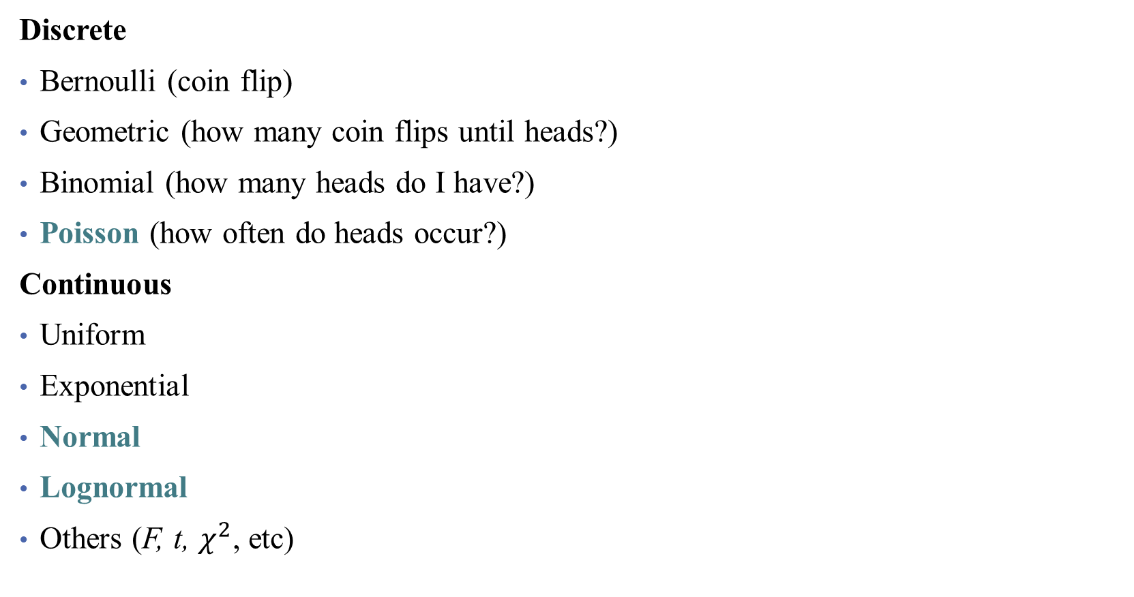
Common Sampling Distributions
Discrete
Bernoulli (coin flip)
Geometric (how many coin flips until heads?)
Binomial (how many heads do I have?)
Poisson (how often do heads occur?)
Continuous
Uniform
Exponential
Normal
Lognormal
Others (F, t, $χ^{2}$, etc)
Seeing Theory
Notes:
Gonna spend more time on these today

Slide 15
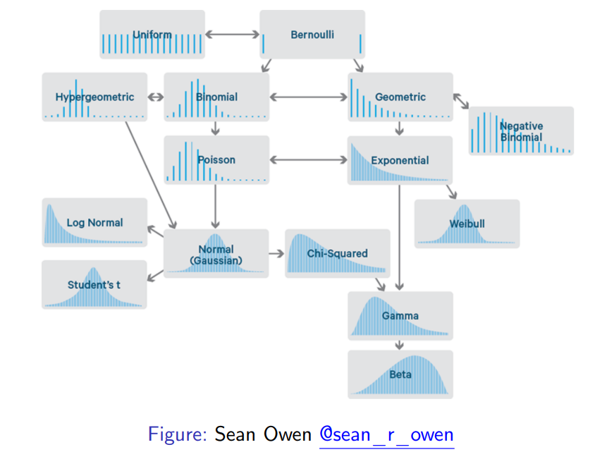
Common Sampling Distributions
Notes:
All distributions are related! We pick the most useful ones.

Slide 16
Normal RVs
Normal random variables are arguably the most important family of RVs. Can be used to approximately fit:
Heights, weights, etc.
Measurement errors in experiments, stock returns, etc.
How sand falls out of a bucket (or a Galton board)
Alex Hoagland (Boston University) 20

Slide 17
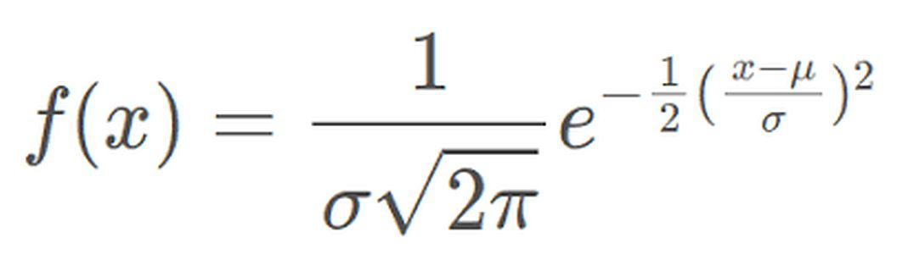
Normal RVs
Normal random variables are arguably the most important family of RVs. Can be used to approximately fit:
Heights, weights, etc.
Measurement errors in experiments, stock returns, etc.
How sand falls out of a bucket (or a Galton board)
The distribution is defined with mean and variance parameters:
Alex Hoagland (Boston University) 20
Notes:
Mathematically, how do you deal with this? It’s a nightmare! But the moment generating function, etc., are actually quite easy to compute. Why is pi in the distribution? Look here: https://www.youtube.com/watch?v=cy8r7WSuT1I.

Slide 18
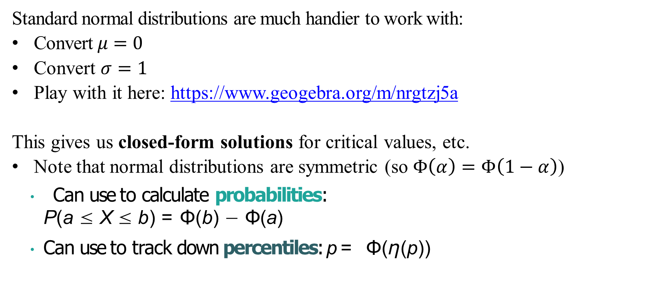
Standard Normal Distribution
Standard normal distributions are much handier to work with:
Convert $μ=0$
Convert $σ=1$
Play with it here: https://www.geogebra.org/m/nrgtzj5a
This gives us closed-form solutions for critical values, etc.
Note that normal distributions are symmetric (so $Φ\left(α\right)=Φ\left(1−α\right)$)
Can use to calculate probabilities:
P(a ≤ X ≤ b) = Φ(b) − Φ(a)
Can use to track down percentiles: p = Φ(η(p))
Alex Hoagland (Boston University) 21

Slide 19
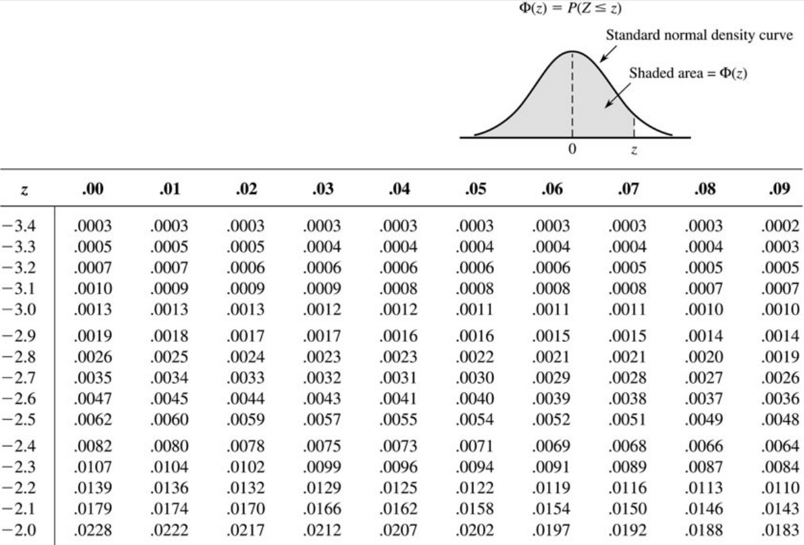
Calculating Normal Values: Table
Notes:
Much easier on computer now. Critical values

Slide 20
Standardization
We use one table (to rule them all) with normals because there is an easy way to map from any normal distributions to a standard normal:
If X ∼ N (µ, σ²)
X − µ σ
Z =
∼ N (0, 1)
Alex Hoagland (Boston University) 25

Slide 21

Example: Stock Returns
Suppose stock in AMH has an annual return $A∼N\left(3,36\right).$What is $\operatorname{Pr}\left(A>5\%\right)?$
Alex Hoagland (Boston University) 26

Slide 22
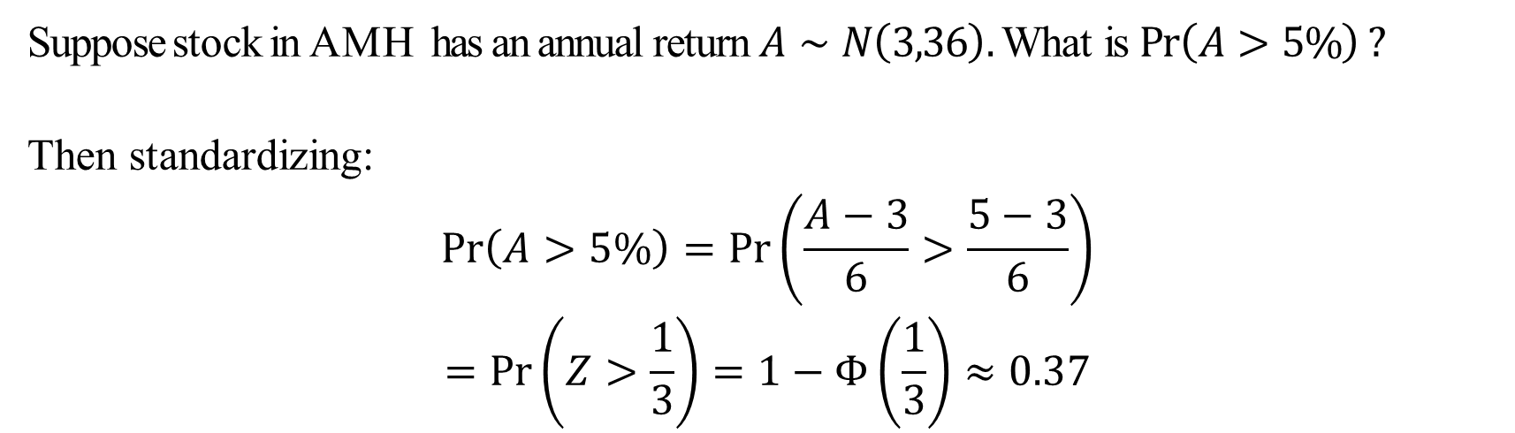
Example: Stock Returns
Suppose stock in AMH has an annual return $A∼N\left(3,36\right).$What is $\operatorname{Pr}\left(A>5\%\right)?$
Then standardizing:
$$\operatorname{Pr}\left(A>5\%\right)=\operatorname{Pr}\left(\frac{A−3}{6}>\frac{5−3}{6}\right)$$
$$=\operatorname{Pr}\left(Z>\frac{1}{3}\right)=1−Φ\left(\frac{1}{3}\right)≈0.37$$
Alex Hoagland (Boston University) 26

Slide 23
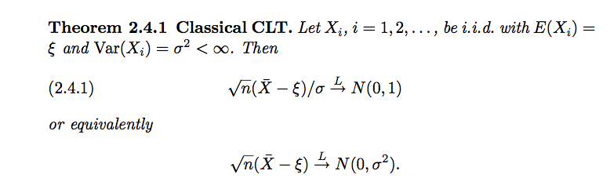
Why are Normal Distributions “Normal”?
What is so important about the normal distribution?
The Central Limit Theorem.
Notes:
I think it’s important to see the math here at least once. Let’s walk through it.

Slide 24
Why are Normal Distributions “Normal”?
What is so important about the normal distribution?
The Central Limit Theorem.
Essentially, for any distribution, if you sample from it enough times, the distribution of the means of your sample will become standard normal!
This makes almost all of our statistical tests work (because we care a lot about means)
Notes:
I think it’s important to see the math here at least once. Let’s walk through it.

Slide 25
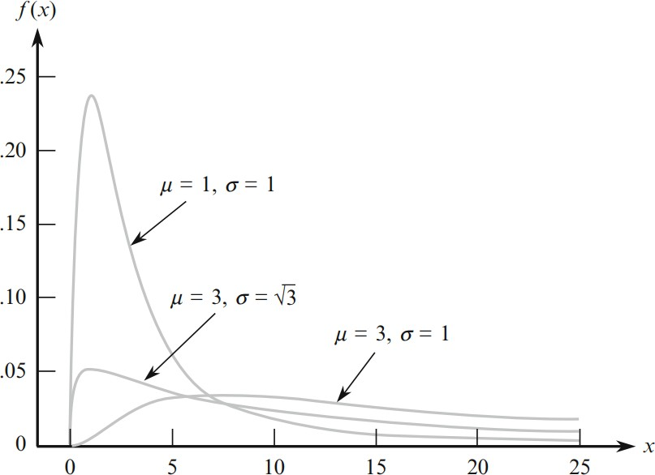
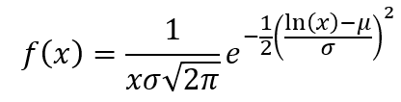

Another Handy Trick: Lognormal Distributions
A variable $X$ whose logarithm $Y$, is normal is called lognormal:
$$Y=\ln\left(X\right)and Y∼N\left(μ,σ^{2}\right)⇒X∼LN\left(μ,σ^{2}\right)$$
Notes:
Turns out that lots of economic variables are (approximately) lognormal!
Example: household income/consumption

Slide 26
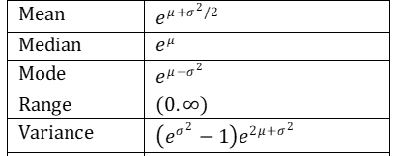

Another Handy Trick: Lognormal Distributions
A variable $X$ whose logarithm $Y$, is normal is called lognormal:
$$Y=\ln\left(X\right)and Y∼N\left(μ,σ^{2}\right)⇒X∼LN\left(μ,σ^{2}\right)$$
Lognormal distributions have some handy moments:
Notes:
I think it’s important to see the math here at least once. Let’s walk through it.

Slide 27
What is a Lognormal Distribution Capturing?
Lognormal distributions capture multiplicative effects rather than additive
E.g., changes in household health may lead to percent changes in consumption (equally likely to double or cut in half) rather than level changes (e.g., +/- $1,000)
This isn’t symmetrical in levels! But it is symmetric in log space

Slide 28
Confidence Intervals

Slide 29
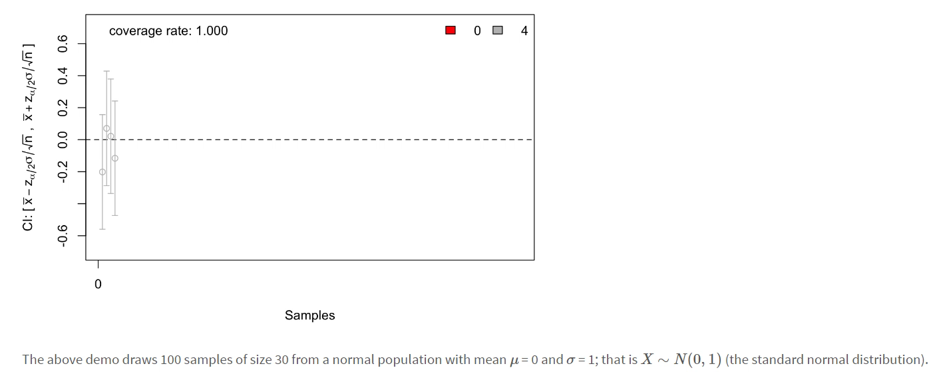
Populations and Samples
But different samples will give us different values for our statistics
We need to accommodate this uncertainty in how we talk about statistics
Another viz: https://twitter.com/EpiEllie/status/1160395672706789376.
Notes:
Source: https://irene.vrbik.ok.ubc.ca/labs/confidence-intervals.html. This is the key idea of confidence intervals: means differ in each sample, but we bound them widely enough that in an infinite number of samples, 99% of the CIs capture the true effect (note these are 99% CIs). (Not that the probability of the true effect in any given CI is 99%).

Slide 30
Calculating a CI
What do we need to assume?
How do we do it?
What can’t a CI deal with?

Slide 31

Calculating a CI
What do we need to assume?
Random sample. If there is sample selection, our estimates of $\overline{x}$ will be biased away from the true underlying value (incorrect coverage of CIs)
Independent observations. Related to (1). Can’t have person X sampled if and only if Y is not, etc.
Accurate data. Always an issue in stats! Worth mentioning here again.
Notes:
Think about a case study: polling people about political opinion. What would violate each of these?

Slide 32
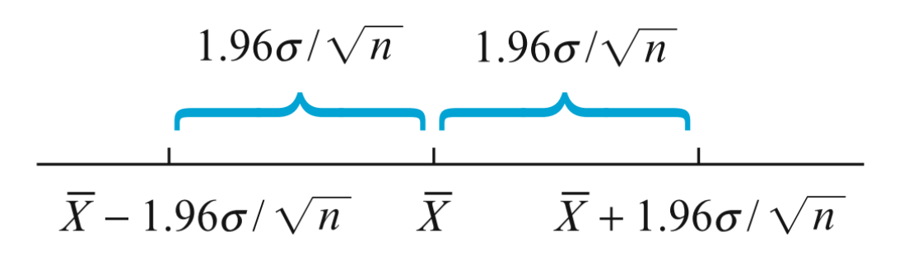

Calculating a CI
How do we calculate a CI?
$$\overline{x}±ME×\hat{SE}(estimate)$$

Slide 33
Calculating a CI
How do we calculate a CI?
$$\overline{x}±ME×\hat{SE}(estimate)$$
Point estimate (sample mean)

Slide 34

Calculating a CI
How do we calculate a CI?
$$\overline{x}±M∗\hat{SE}(estimate)$$
Point estimate (sample mean)
Standard Error (depends on point estimate)

Slide 35

Calculating a CI
How do we calculate a CI?
$$\overline{x}±M(α)∗\hat{SE}(estimate)$$
Point estimate (sample mean)
Standard Error (depends on point estimate)
Multiplier for margin of error (depends on chosen level of confidence)
Notes:
Multipliers depend on the sampling distribution of the underlying variable – e.g., for a standard normal, the multiplier values are 1.96 for 95% and 2.576 for 99%.

Slide 36

Calculating a CI for a Mean
Suppose we estimate the average (systolic) blood pressure pressure of a sample (N=45) to be 115 with a standard deviation of 10. What is the 95% confidence interval?
$$\overline{x}±M(α)∗\hat{SE}(estimate)$$

Slide 37
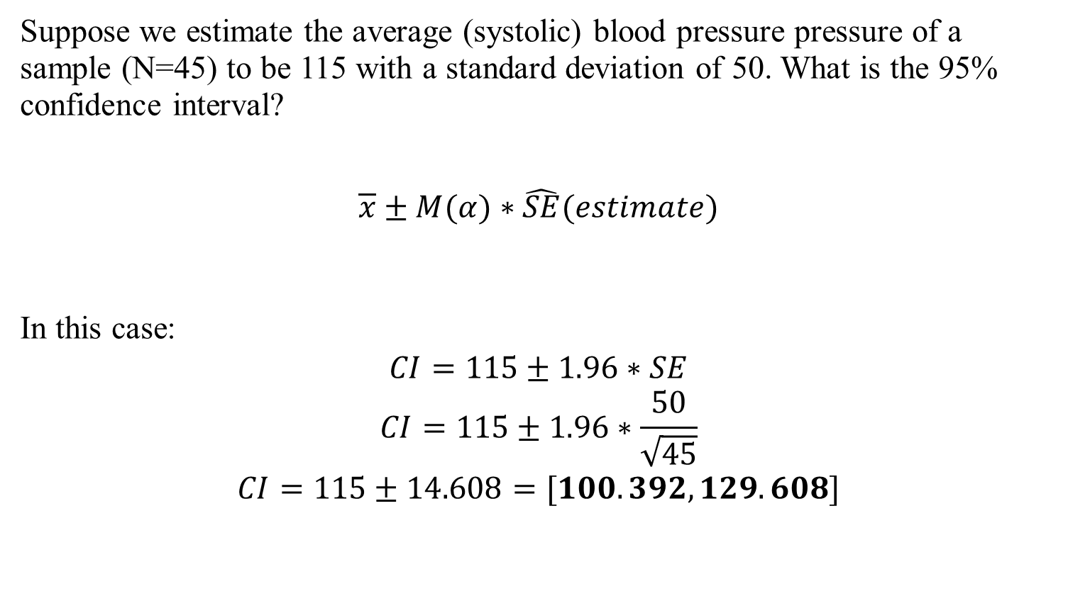
Calculating a CI for a Mean
Suppose we estimate the average (systolic) blood pressure pressure of a sample (N=45) to be 115 with a standard deviation of 50. What is the 95% confidence interval?
$$\overline{x}±M(α)∗\hat{SE}(estimate)$$
In this case:
$$CI=115±1.96∗SE$$
$$CI=115±1.96∗\frac{50}{\sqrt{45}}$$
$$CI=115±14.608=[100.392,129.608]$$
Notes:
Talk about how we write this in the final form. How do we interpret this?

Slide 38
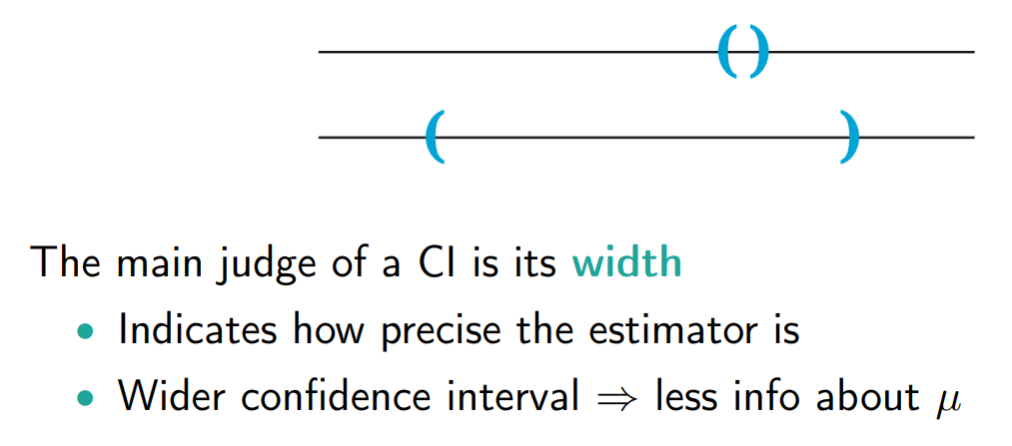
Interpreting a CI
How do we calculate a CI?
$$\overline{x}±ME×\hat{SE}(estimate)$$
Notes:
In particular, intervals that include/don’t include zero are particularly meaningful (we’ll return to this for hypothesis testing)

Slide 39
Calculating a CI
What can’t a CI deal with?
Violations of assumptions
Sample selection and measurement error are big
Other things can be dealt with (e.g., block/stratified sampling)
There are workarounds: bootstrapping, machine learning, conservative SEs
In general, your CIs are probably too narrow (but that’s okay – research is a joint process!)

Slide 40
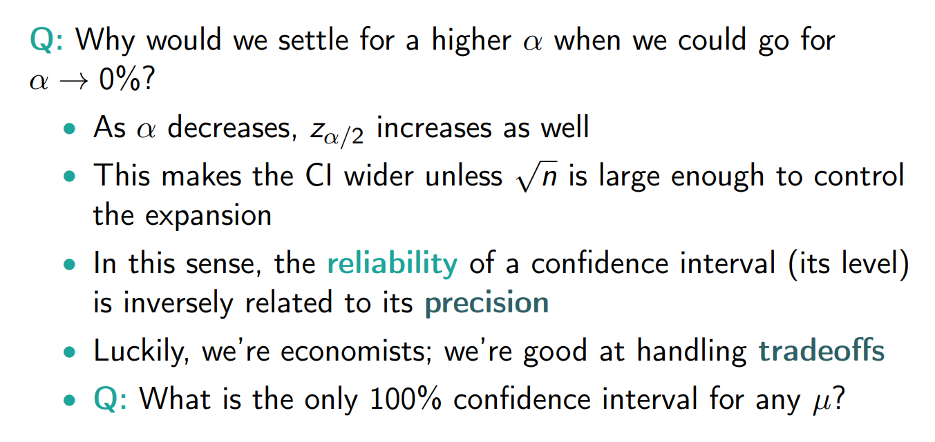
Calculating a CI
What can’t a CI deal with?

Slide 41
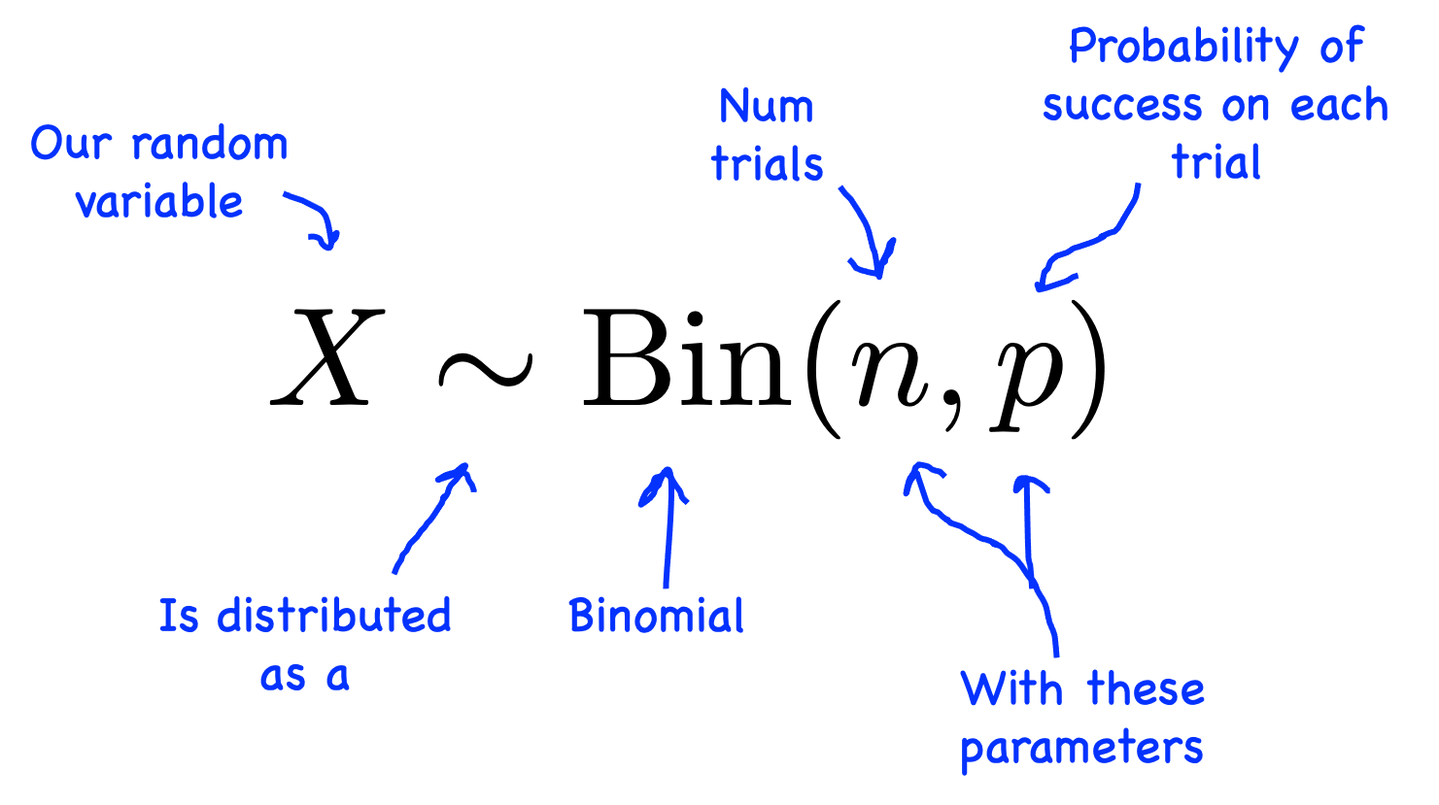

Example: Binomial Distribution + CI
In many cases, the variable we care about is a proportion
For example, the incidence of a medical condition: $x∈\left\{0, 1\right\}$
The statistic is then $\overline{x}:$ % of the sample/population with the condition
This is modeled as $N$ draws from the binomial distribution:

Slide 42
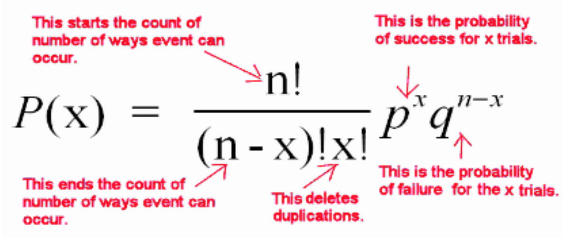
Example: Binomial Distribution + CI
In many cases, the variable we care about is a proportion
For example, the incidence of a medical condition: $x∈\left\{0, 1\right\}$
The statistic is then $\overline{x}:$ % of the sample/population with the condition
This is modeled as $N$ draws from the binomial distribution:
Notes:
For the math-inclined

Slide 43
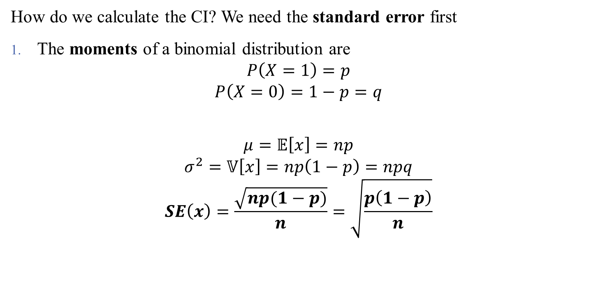
Example: Binomial Distribution + CI
How do we calculate the CI? We need the standard error first
The moments of a binomial distribution are
$$P\left(X=1\right)=p$$
$$P\left(X=0\right)=1−p=q$$
$$μ=𝔼\left[x\right]=np$$
$$σ^{2}=𝕍\left[x\right]=np\left(1−p\right)=npq$$
$$SE\left(x\right)=\frac{\sqrt{np(1−p)}}{n}=\sqrt{\frac{p\left(1−p\right)}{n}}$$
Notes:
For the math-inclined, derivation is here: https://www.google.com/url?sa=i&url=https%3A%2F%2Fmath.stackexchange.com%2Fquestions%2F2477817%2Fcalculating-the-second-moment-of-a-binomial-random-variable&psig=AOvVaw1u4LWLEFwcxjIRbYOrbD6n&ust=1697145876848000&source=images&cd=vfe&opi=89978449&ved=0CAUQjB1qFwoTCNjr05737oEDFQAAAAAdAAAAABAE.

Slide 44
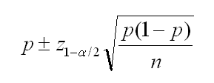

Example: Binomial Distribution + CI
How do we calculate the CI?
So the standard error is $\sqrt{\frac{p\left(1−p\right)}{n}}$
Then, the confidence interval is given by
Notes:
Easy as pi(e)!

Slide 45
Other CI Examples
Notes:
Survival + Count Data

Slide 46
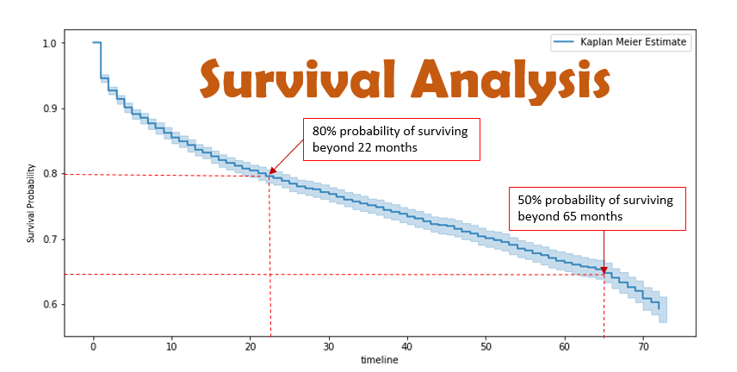
Example: Survival Data
Often we are interested in event durations rather than incidences
How long was a patient on dialysis?
How long between first visit and diagnosis?
Notes:
Survival curves tell us something about the expected duration of an event (conditional or unconditional). Frequently, this data is censored in the sense that we don’t follow patients forever. We’ll talk about this more after the midterm.

Slide 47
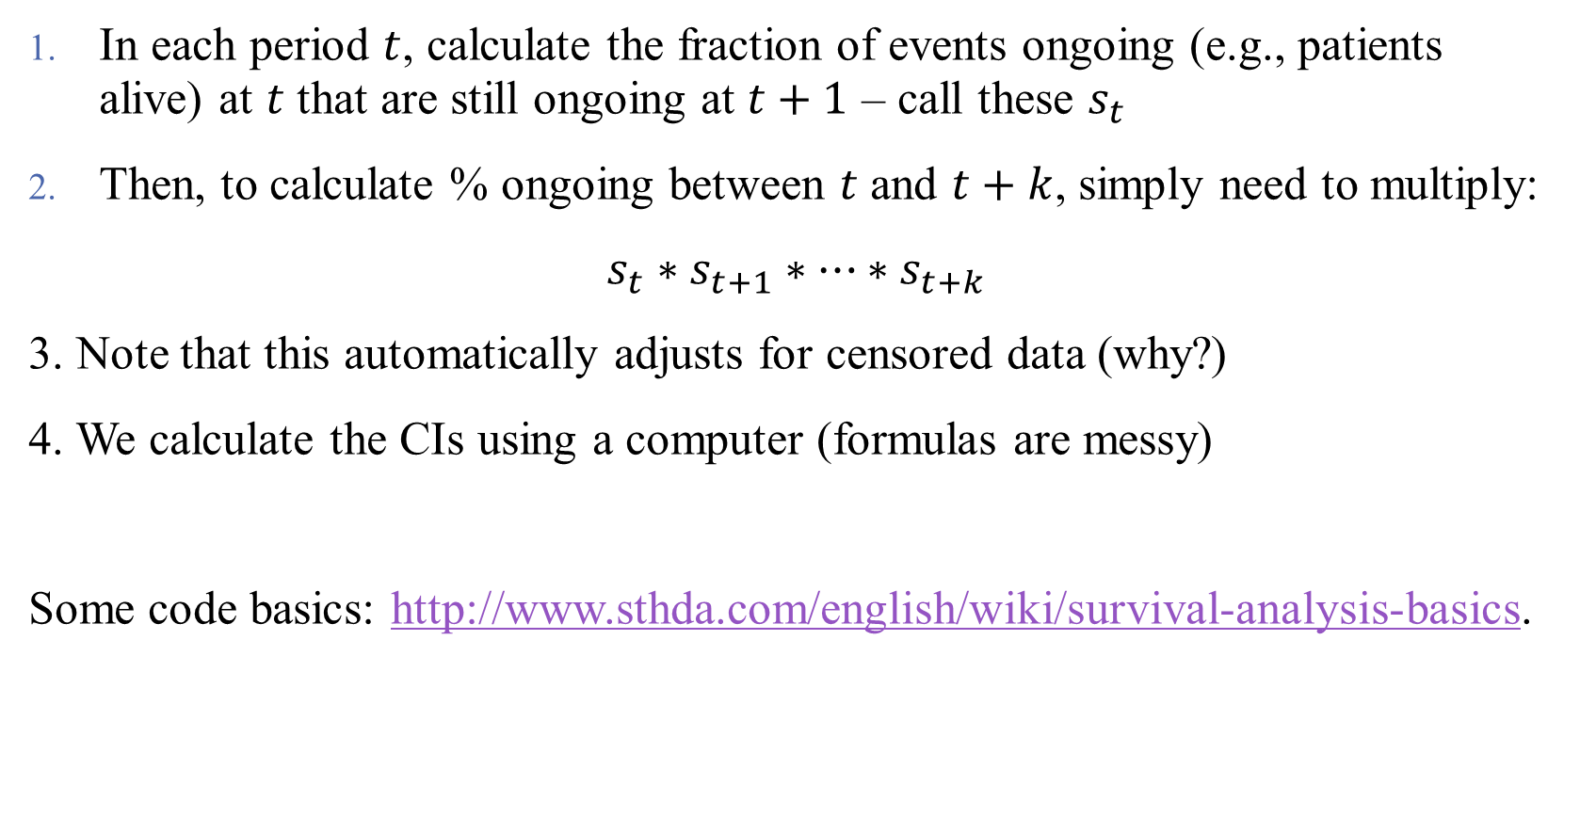
How to Construct Survival Curves
In each period $t$, calculate the fraction of events ongoing (e.g., patients alive) at $t$ that are still ongoing at $t+1$ – call these $s_{t}$
Then, to calculate % ongoing between $t$ and $t+k$, simply need to multiply:
$s_{t}∗s_{t+1}∗…∗s_{t+k}$
3. Note that this automatically adjusts for censored data (why?)
4. We calculate the CIs using a computer (formulas are messy)
Some code basics: http://www.sthda.com/english/wiki/survival-analysis-basics.
Notes:
We really only care about the Kaplan-Meier method. For information on (4) see https://dominicmagirr.github.io/post/2022-01-18-be-careful-with-standard-errors-in-survival-survfit/.

Slide 48
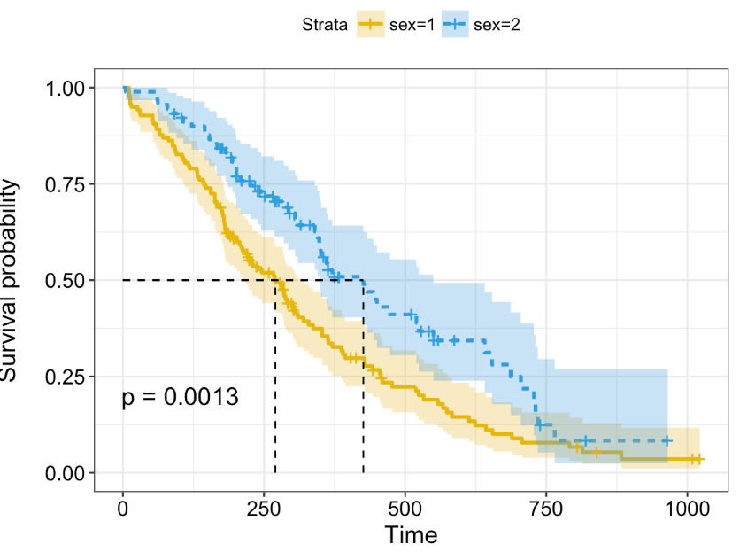
How to Read Survival Curves
Notes:
Talk about (1) general overview of estimates, (2) CIs, (3) median survival, and (4) differences between groups (are they significant?)

Slide 49
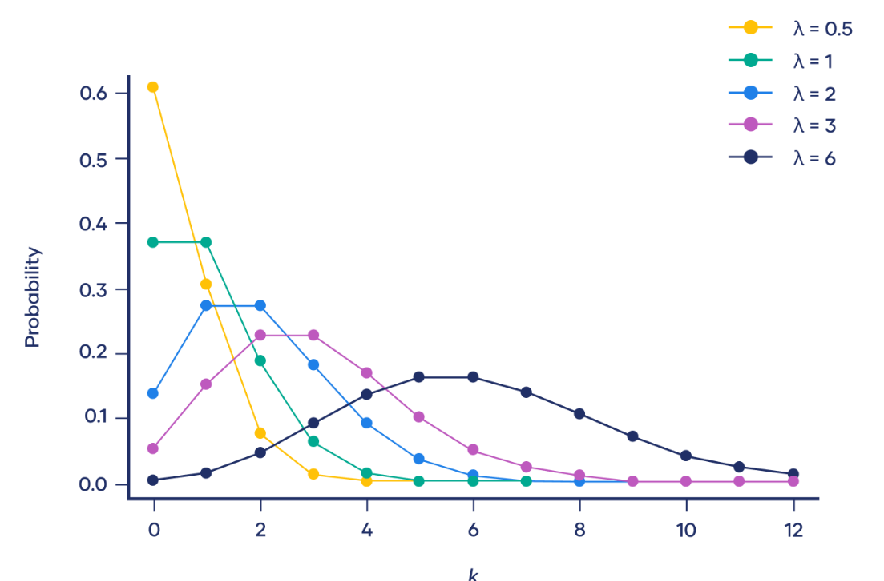
Example: Count Data
We might also be interested in event counts rather than incidences
How many drugs is a person taking?
How many hospitals opt into an incentive program?
Notes:
We model these with the Poisson distribution. Note that the Poisson starts to approximate normal distributions as its key parameter increases, so we are usually interested in the settings with low-counts (when we can’t approximate this problem away). What kind of events are those?

Slide 50
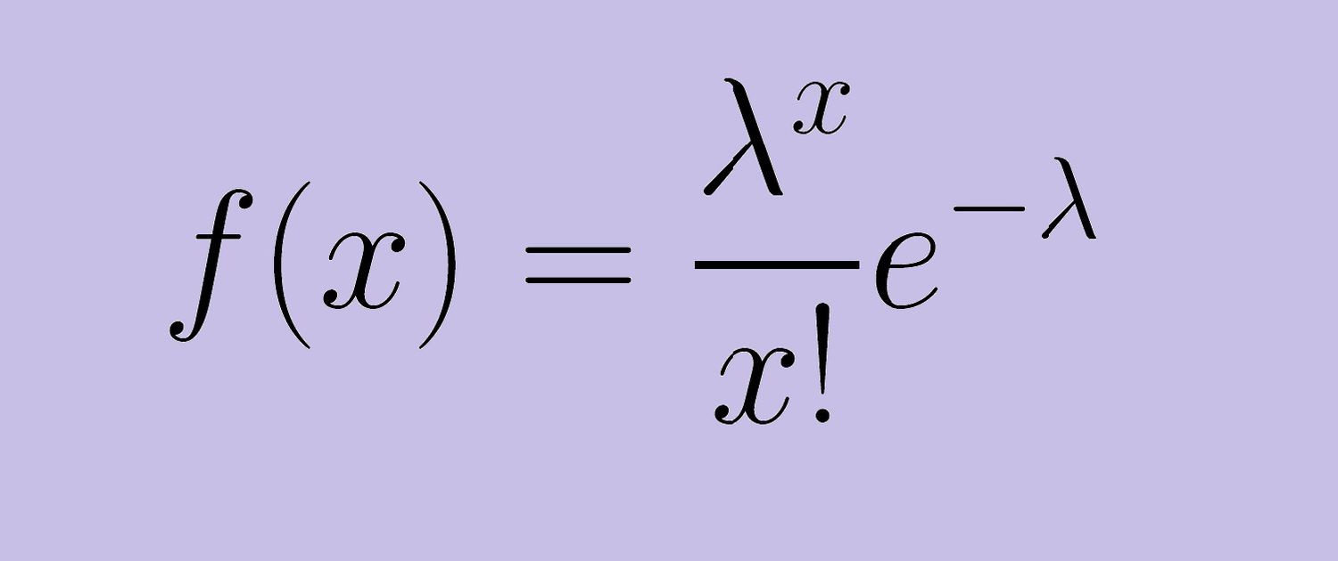
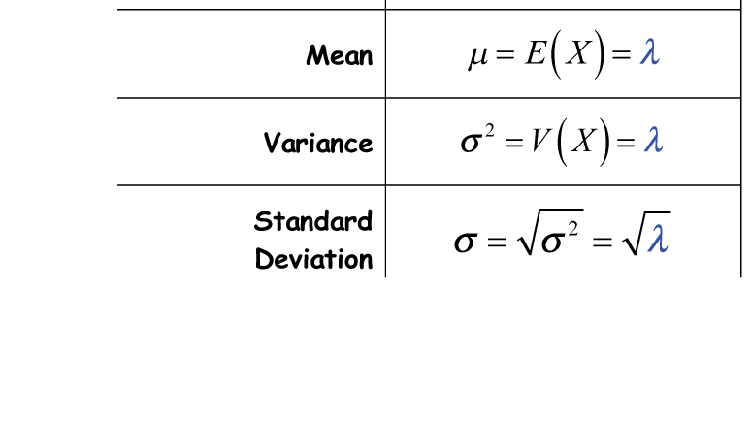
The Poisson Distribution
Assumptions on the Poisson Distribution
Events are clearly defined, are i.i.d., and are well-counted (e.g., counted once)
Notes:
Our book tends to make the assumptions seem more strenuous than they are generally. This distribution is handy because the whole distribution is characterized by a single parameter (lambda), making its SE easy to compute! And as the book mentions, SE can be handily approximated by the sqrt(count) (which is the estimator for the mean) .

Slide 51
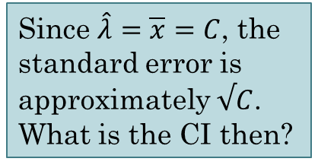
The Poisson Distribution
Assumptions on the Poisson Distribution
Events are clearly defined, are i.i.d., and are well-counted (e.g., counted once)
Since $\hat{λ}=\overline{x}=C$, the standard error is approximately $√C$. What is the CI then?
Notes:
Our book tends to make the assumptions seem more strenuous than they are generally. This distribution is handy because the whole distribution is characterized by a single parameter (lambda), making its SE easy to compute! And as the book mentions, SE can be handily approximated by the sqrt(count) (which is the estimator for the mean) .

Slide 52
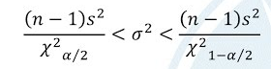

Calculating a CI for a Standard Deviation
Can we calculate the CI for a standard deviation? (Note: why would we want this?)
The formula goes from:
$$\overline{x}±M(α)∗\hat{SE}(estimate)$$
To:
Notes:
There are more distributions for us to learn! But not too hard to extend in R (moral of the story: know what you’re doing in R “under the hood”. Preferably, do your own math/estimator coding).

Slide 53
Calculating a CI for Differences in Means/Proportions/SDs/etc.
A single CI isn’t really that interesting
If we have too much uncertainty, how can we fix it? Just get more data!
What we really care about is uncertainty relative to other groups in the data
Notes:
This will become incredibly important in the next lecture!

Slide 54
Calculating a CI for Differences in Means/Proportions/SDs/etc.
A single CI isn’t really that interesting
If we have too much uncertainty, how can we fix it? Just get more data!
What we really care about is uncertainty relative to other groups in the data
This is the question of differences in estimates:
Do men experience this more than women?
Do children have higher incidence than adults?
Comparisons are vital in understanding causal pathways and mechanisms!
Notes:
This will become incredibly important in the next lecture!

Slide 55
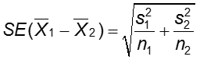
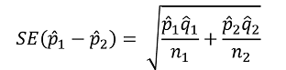
Calculating a CI for Differences in Means/Proportions/SDs/etc.
Logistics here depend on the comparison at hand:
Different comparisons = different distributions
The real trick is in calculating standard errors of differences:
Also depends on if the data are “paired” or not
Luckily, R can handle it all!
Notes:
This will become incredibly important in the next lecture!

Slide 56
Bootstrapping & CI Theory

Slide 57
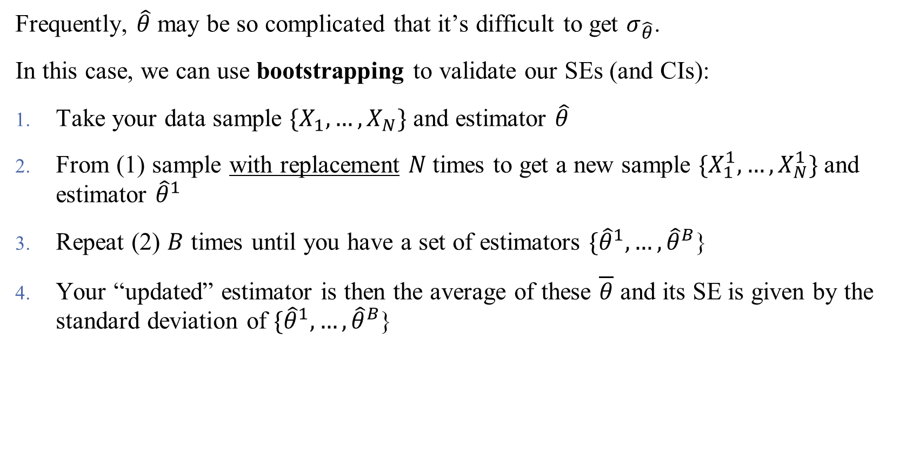
Bootstrapped Standard Errors
Frequently, $\hat{θ}$ may be so complicated that it’s difficult to get $σ_{\hat{θ}}$.
In this case, we can use bootstrapping to validate our SEs (and CIs):
Take your data sample $\{X_{1},…, X_{N}\}$ and estimator $\hat{θ}$
From (1) sample with replacement $N$times to get a new sample $\{X_{1}^{1},…, X_{N}^{1}\}$ and estimator ${\hat{θ}}^{1}$
Repeat (2) $B$ times until you have a set of estimators $\{{\hat{θ}}^{1},…, {\hat{θ}}^{B}$}
Your “updated” estimator is then the average of these $\overline{θ}$ and its SE is given by the standard deviation of $\{{\hat{θ}}^{1},…, {\hat{θ}}^{B}$}

Slide 58
Bootstrapped Standard Errors
Frequently, θ^{ˆ} may be so complicated that σ_{θˆ} isn’t easily obtained. In this case, we use a simulation called bootstrapping to obtain valid SEs:
Begin with your sample {X₁, ..., X_{n}}
From that sample, sample again with replacement to get
1 1
{X , ..., X }
1 n
Calculate θ^{ˆ1} using that sample
Repeat steps (2) and (3) B times to obtain B different estimates of θ, {θ^{ˆ1}, ..., θ^{ˆB} }.
Calculate the mean θ∗ of these estimates, and standard errors:
1
B
ˆ
∗
S_{θˆ} =
i
2
(θ − θ )
B − 1 _{i =1}
Notes:
Can you figure this out in R? We kind of have some sample code you can adapt here already. Play around with it!

Slide 59
This Time
Sampling Distributions
Standard Errors and Confidence Intervals
Bootstrapping
Next Time
p values
Hypothesis testing

